Slide 1

B.TECH PROJECT · PROGRESS PRESENTATION
Reactive Synthesis and Laser Surface Processing for
In-Situ Ceramic Matrix Composite Coatings on Low-Carbon Steel: Development and Adhesion Analysis
Samith lal . B Roll No: [230003013]
Supervisor: prof Satyajit Chatterjee
Department: [Mechanical Engineering]

Slide 2
BACKGROUND
From Low-Carbon Steel to Ceramic Matrix Composite(CMC) Coatings
1 | SUBSTRATE — AISI 1025 LOW-CARBON STEEL
( C : 0.25% )
2 | CERAMIC MATRIX COMPOSITE (CMC) COATING
Project substrate: 100 × 50 × 8 mm
A ceramic-rich surface layer designed to place hard, thermally stable phases where they are needed.
Good bulk mechanical properties, ductility and machinability
Low cost, readily available and widely used in engineering structures
However, the surface is not inherently designed for severe wear or high-temperature service
Surface limitations become critical when hardness, wear resistance and thermal stability are required
Raises surface hardness and resistance to abrasive / sliding wear
Introduces refractory ceramic phases for demanding thermal environments
Can form phases in situ during reactive processing, giving a metallurgically integrated surface
Literature examples include TiB₂–TiC, Al₂O₃–TiB₂–TiN, ZrB₂–ZrC/Cu and (TiB₂+TiC)/Cu coatings
Project system: 4Al + 3TiO₂ + 2BN → 2Al₂O₃ + TiB₂ + 2TiN
Need: improve surface performance without replacing the steel bulk
WHY CMC COATINGS? | Surface engineering for high-hardness, wear- and thermally demanding applications
et al. (2008); Dey et al. (Literature basis: Bao et al. (2020); Chatterjee 2020); Lv et al. (2020); Zhang et al. (2025).
02

Slide 3
BACKGROUND
Self-Propagating High-Temperature Synthesis (SHS)
HOW DOES IT BECOME “SELF-PROPAGATING”?
WHAT IS SHS?
A highly exothermic reaction in which an initial ignition event starts a combustion reaction that can sustain itself through the reactant mixture.
1
→
2
→
3
→
4
Ignition
Exothermic reaction
Heat transfer
Propagation
External heat initiates the reaction locally.
Chemical heat is released at the reaction front.
Released heat ignites neighbouring reactants.
The reaction front travels through the powder.
Key idea: the external source only needs to provide the initial ignition (and, depending on the process, local heat for surface processing).
The reaction itself supplies the heat needed for propagation.
DIFFERENT POWER SOURCES USED TO TRIGGER / SUSTAIN SHS-BASED COATING PROCESSES
ARC / GTAW
LASER
INDUCTION
Wire-arc deposition
CO₂ / semiconductor laser
High-frequency induction
Arc heats the cored wire and triggers the combustion reaction.
Highly localized heating; used for laser-triggered SHS and laser cladding/alloying.
Induction remelting supplies heat and triggers the in-situ SHS reaction.
Bao et al. (2020)
Chatterjee et al. (2008); Dey et al. (2020); Lv et al. (2020)
Zhang et al. (2025)
et al. (2008); Dey et al. (Literature basis: Bao et al. (2020); Chatterjee 2020); Lv et al. (2020); Zhang et al. (2025).
03

Slide 4
RESEARCH GAP & STUDY FRAMEWORK
WHAT IS ESTABLISHED?
• Ceramic-rich coatings can provide high hardness, wear resistance and thermal stability.
• SHS enables in-situ formation of ceramic phases from reactive precursor powders.
•The idea of interlayer in this research comes from the application of bond coat in plasma alumina coating deposition process.
NOVELTY
Influence of an electrodeposited Ni/ Ni–Al/Ni-Cr intermediate layer on the adhesion and interfacial behavior of an SHS-derived
Al–TiB₂–TiN CMC coating on low-carbon steel.
CONTROLLED COMPARISON
A
B
AISI 1025
CMC coating
AISI 1025
Ni/Ni–Al/Ni-Cr
CMC
Direct coating architecture
Electrodeposited intermediate-layer architecture
EVALUATION
WORKING HYPOTHESIS
• Coating–substrate adhesion • Interface / microstructure
• Hardness and other experimentally measured properties
Ni/Ni–Al/Ni-Cr may act as a transition layer that modifies thermal and mechanical mismatch at the steel–ceramic interface.
et al. (2008); Dey et al. (Literature basis: Bao et al. (2020); Chatterjee 2020); Lv et al. (2020); Zhang et al. (2025).
04

Slide 5
WORK PLAN & OBJECTIVES
Overall scope: development, optimization, comparison and characterization of the CMC coating system.
01
DEVELOP
Develop a ceramic matrix composite coating on low-carbon steel using high-temperature synthesis and laser technology.
02
OPTIMIZE
Optimize laser processing parameters for stable and consistent coating formation.
Investigate the effect of introducing a Ni/ Ni–Al/ Ni-Cr intermediate coat between the
substrate and final ceramic coating.
03
INVESTIGATE
04
CHARACTERIZE
Characterize the coatings using microstructural, mechanical and tribological investigations.
COMPARE
Compare the coating system on bare low-carbon steel with the coating system incorporating
the Ni/ Ni–Al/ Ni-Cr intermediate layer.
05
Core comparison: AISI 1025 → CMC vs. AISI 1025 → Ni/ Ni–Al/ Ni-Cr → CMC
05

Slide 6
METHODOLOGY — FABRICATION & LASER PROCESSING
Preparation → Coating architecture → Precursor reaction → Laser processing
AISI 1025
SURFACE PREPARATION
TWO COATING ARCHITECTURES
100 × 50 × 8 mm
Polishing/Cleaning
Direct CMC vs. Ni/ Ni–Al/ Ni-Cr intermediate-layer CMC
ROUTE A — DIRECT CMC
ROUTE B — Ni–Al INTERMEDIATE
Bare AISI 1025
↓
Electrodeposited Ni/ Ni–Al/ Ni-Cr l layer
↓
Al + TiO₂ + h-BN precursor
↓
Laser-assisted SHS
↓
Ni/ Ni–Al/ Ni-Cr + Al₂O₃–TiB₂–TiN CMC coating
Bare AISI 1025
↓
Al + TiO₂ + h-BN precursor
↓
Laser-assisted SHS
↓
Al₂O₃–TiB₂–TiN CMC coating
Process-parameter optimization
and stable coating formation
SHS REACTION
4Al + 3TiO₂ + 2BN → 2Al₂O₃ + TiB₂ + 2TiN
LASER
Output: two coating architectures for comparative characterization.
06

Slide 7
METHODOLOGY — CHARACTERIZATION & EVALUATION
g
MICROSTRUCTURAL & PHASE
MECHANICAL
TRIBOLOGICAL
• Microhardness
• Scratch test
• Fracture toughness
• Optical Microscopy • SEM/EDS • XRD
Sliding wear test
Microstructure, elemental distribution and phase formation
Hardness, damage/delamination
response and fracture behavior
Wear behavior under sliding conditions
COMPARATIVE EVALUATION
A | AISI 1025 → CMC
B | AISI 1025 → Ni/ Ni–Al/ Ni-Cr → CMC
Direct coating architecture
Intermediate-layer architecture
Coating–substrate adhesion | Microstructure | Phase formation | Microhardness
Scratch response | Fracture toughness | Sliding wear
MEASURE & COMPARE
07
The same characterization framework is applied to both coating architectures.

Slide 8
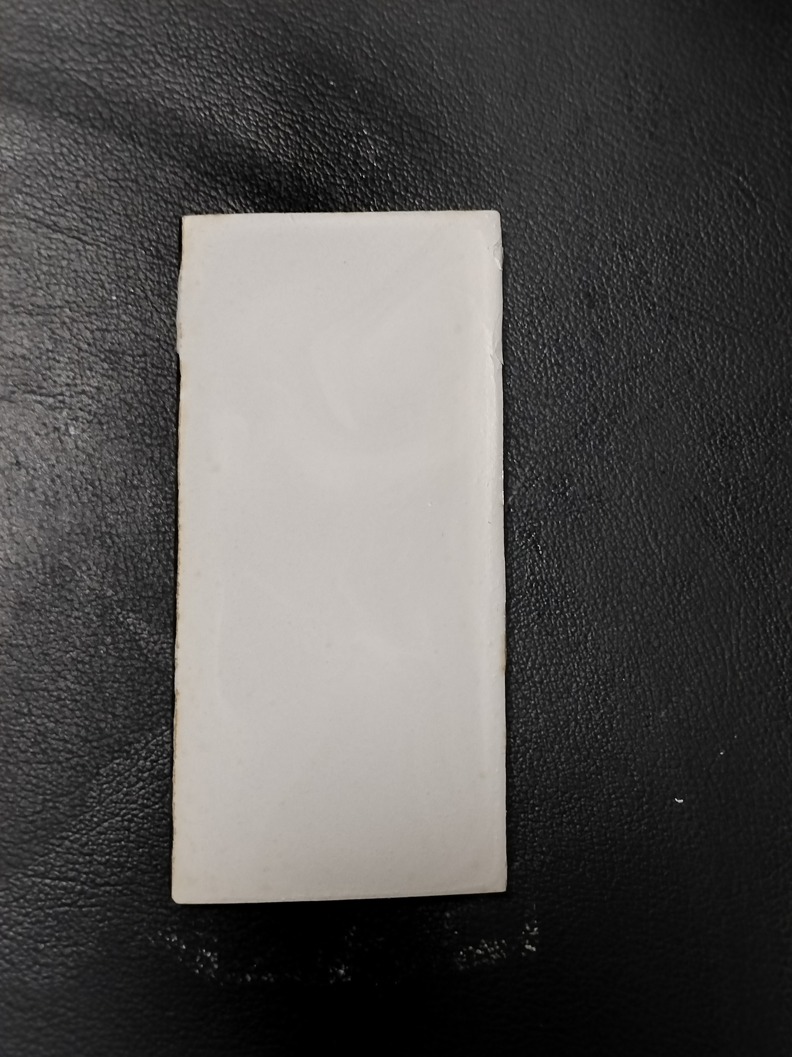
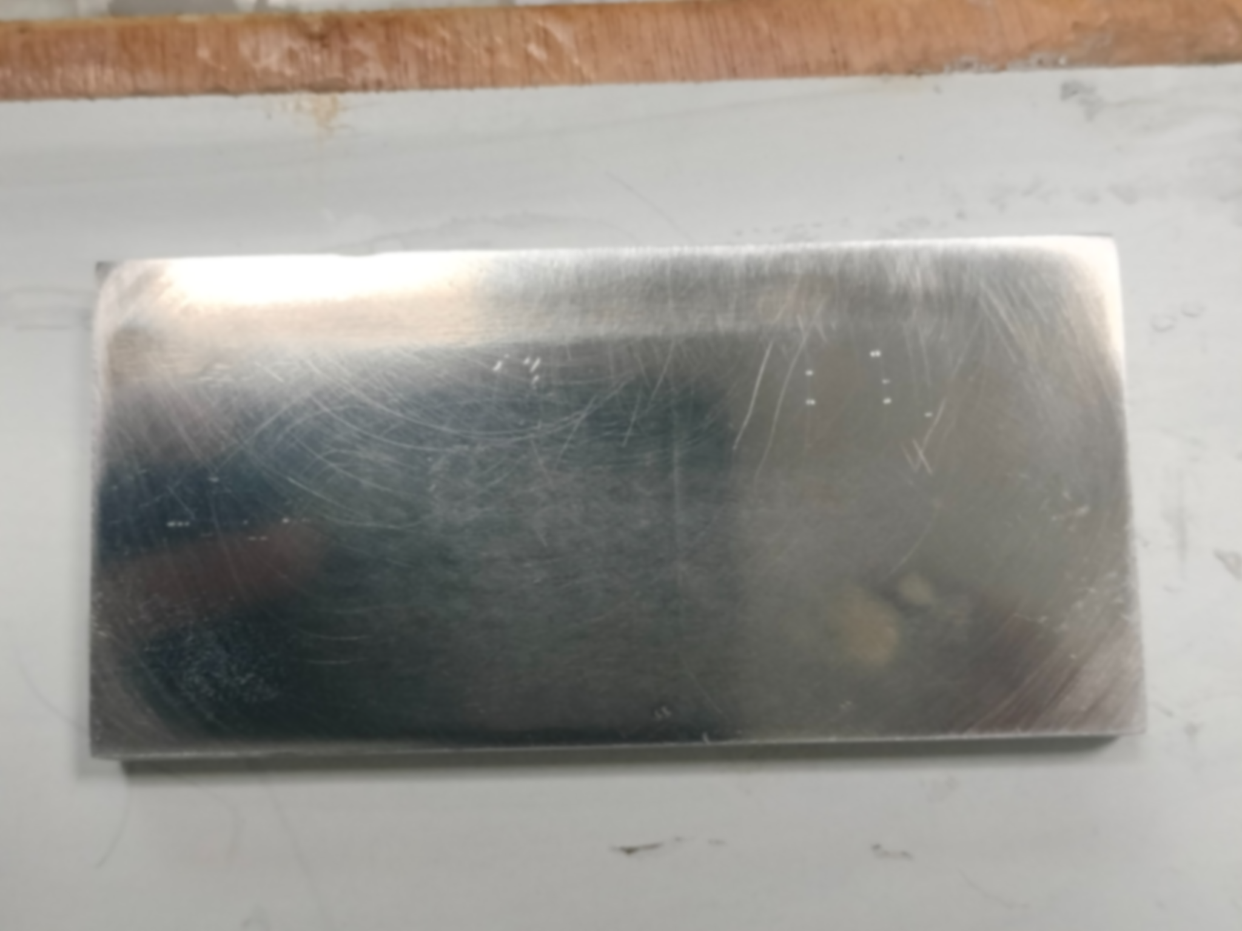
CURRENT WORK DONE — SUBSTRATE & PRECURSOR PREPARATION
Route A: in-situ CMC coating trials on low-carbon steel
100 × 50 × 8 mm
AISI 1025 low-carbon steel substrate
Pre-placed precursor layer
Prepared substrate for in-situ coating trials
Al–TiO₂–hBN slurry after placement / drying
Al = 1.09 g TiO₂ = 2.41 g h-BN = 0.50 g (TOTAL 4grams)
COMPLETED
• Low-carbon-steel specimens prepared
• Al–TiO₂–hBN precursor system prepared and placed on the substrate
• In-situ trial samples prepared for laser processing
Al : 99.5% purity 325 mesh powder
TiO₂ : 99.5% purity 325 mesh powder
hBN : 99.5% purity 325 mesh powder
Current stage: Route A — fabrication and laser-parameter optimization.
08

Slide 9
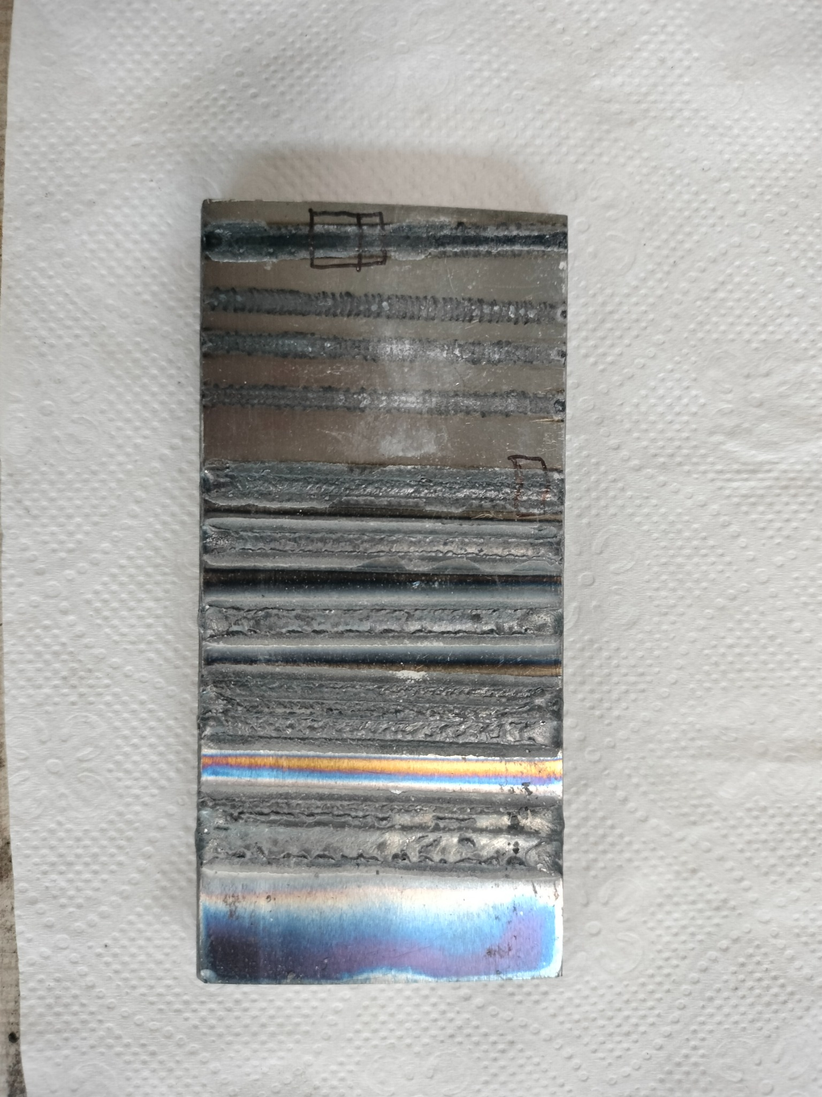
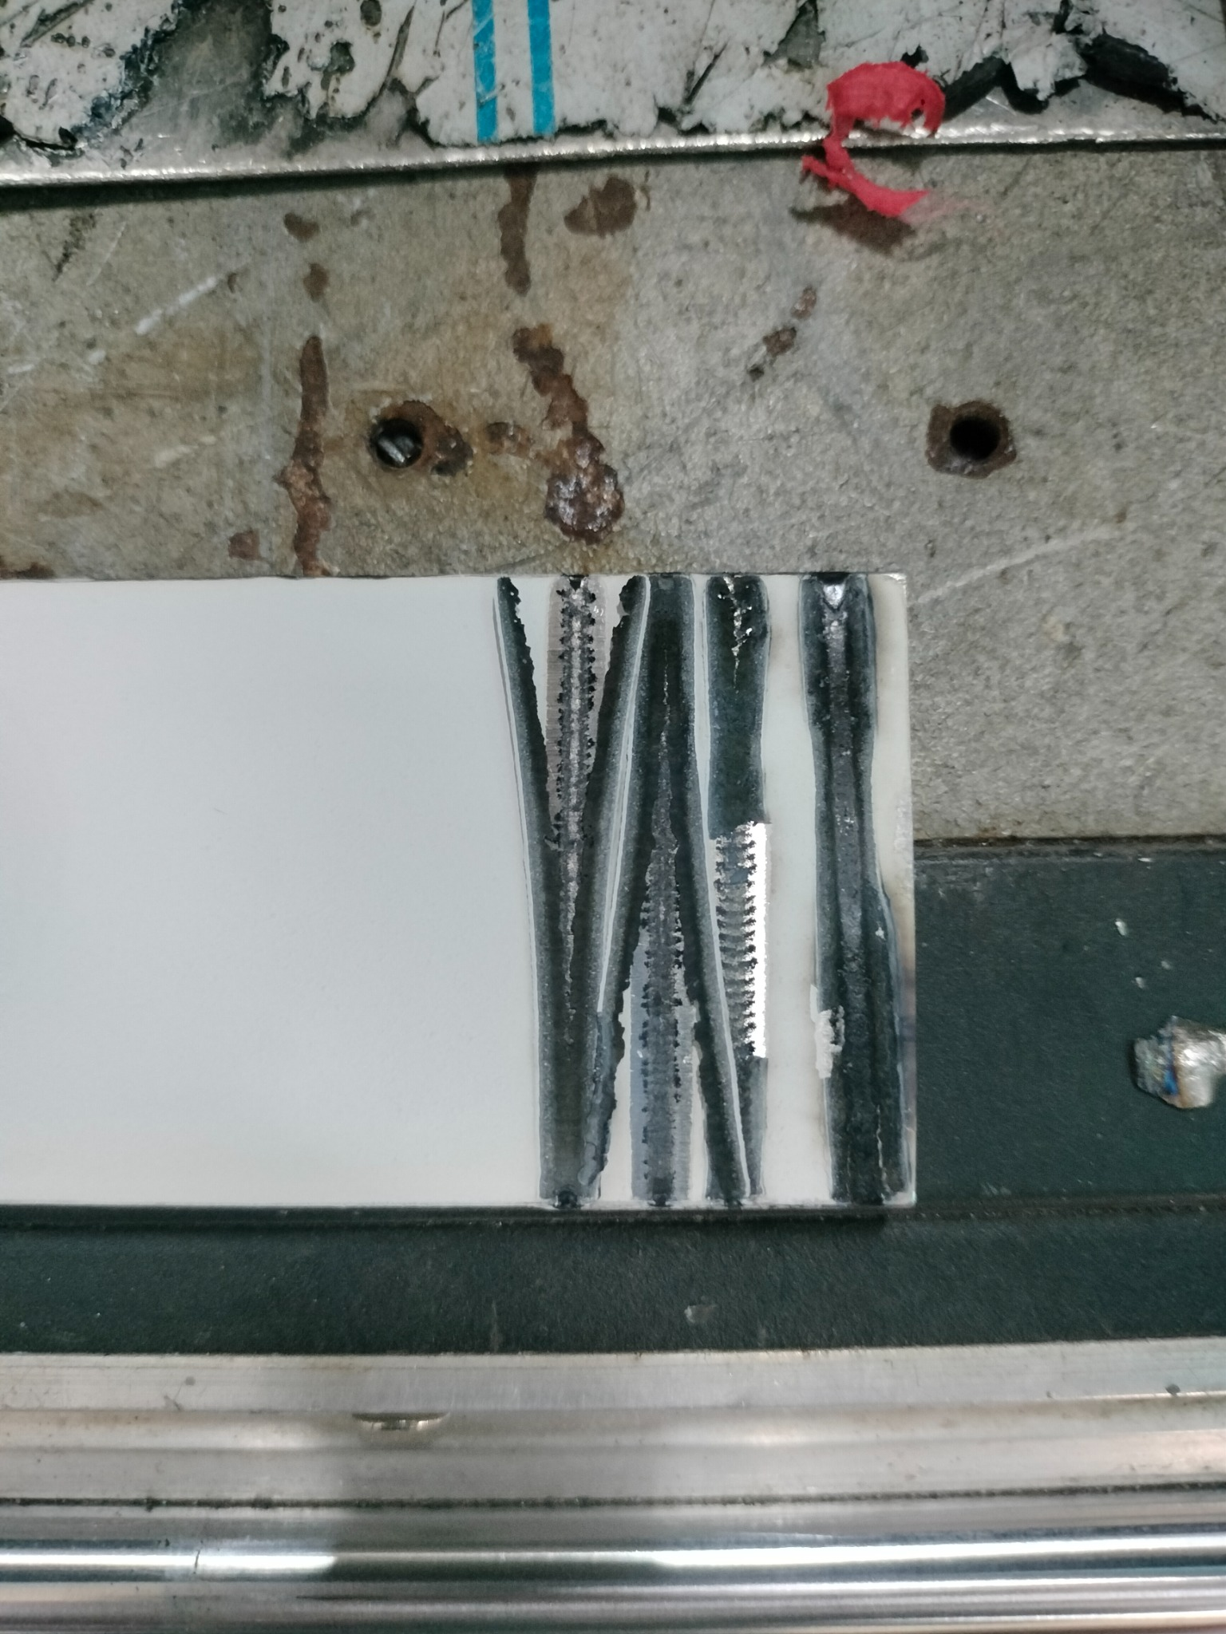
CURRENT WORK DONE — LASER TRIALS & PARAMETER REFINEMENT
Initial trials were used to identify processing conditions that produce a stable coating
Initial laser trials
Laser-processed trial specimen
Localized coating delamination / inconsistent track formation
Multiple laser tracks after parameter refinement
: Initial processing showed localized delamination, indicating the need for parameter refinement. Subsequent trials were used to narrow the laser-processing window for stable coating formation.
KEY OBSERVATION
Optimization outcome: refined conditions selected for subsequent in-situ samples.
09

Slide 10
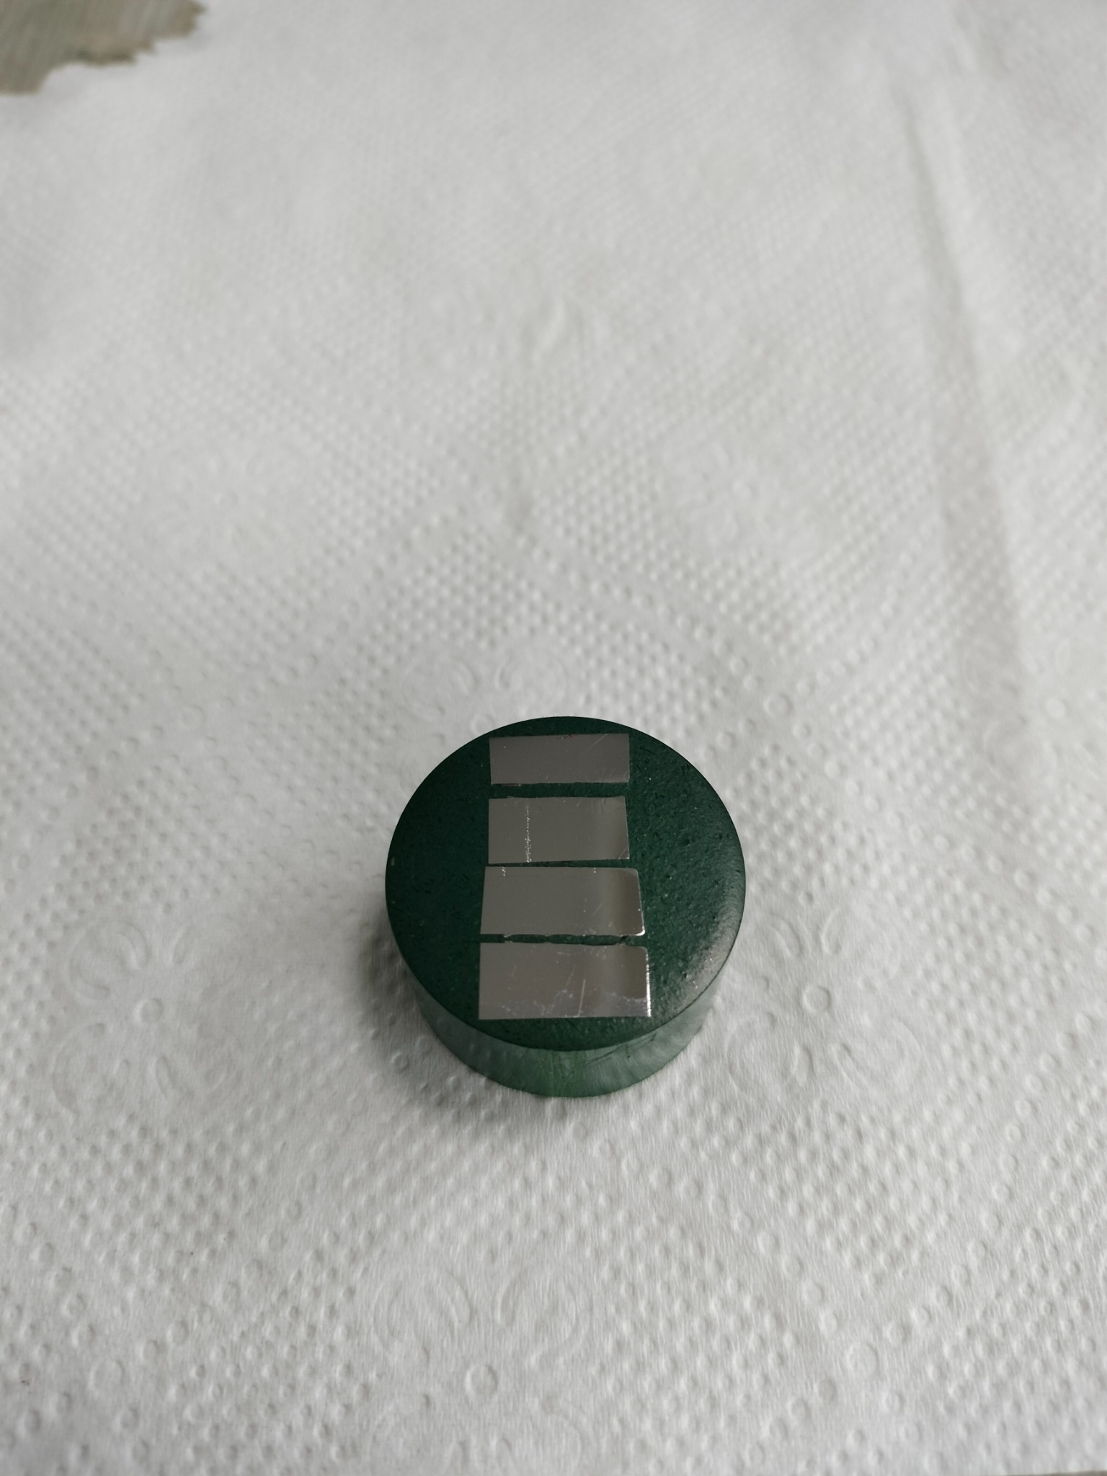
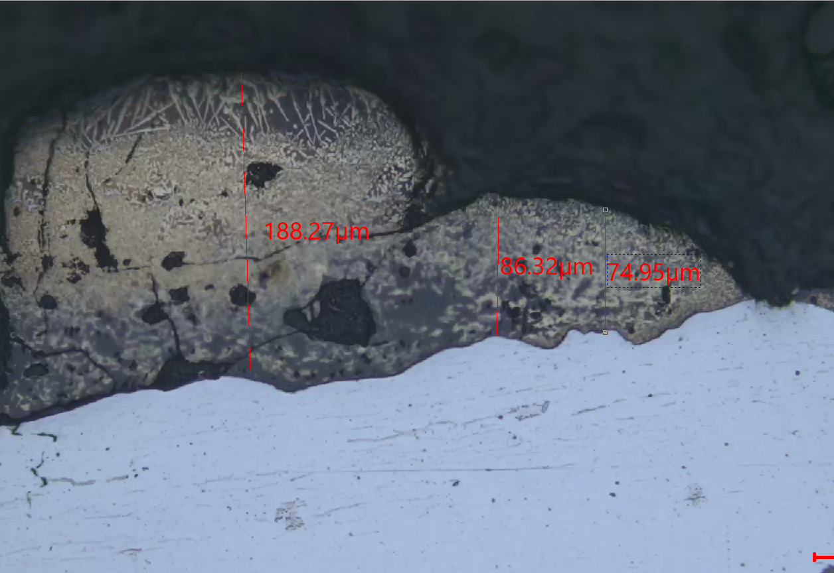
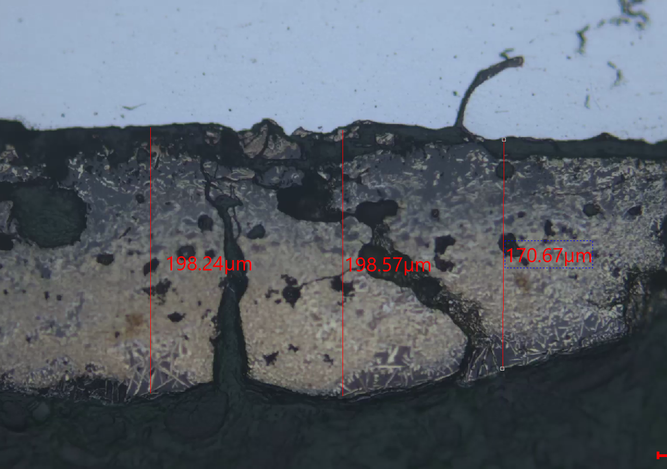
CURRENT WORK DONE — SECTIONING, METALLOGRAPHY & PRELIMINARY OBSERVATIONS
Cross-sectional preparation completed for optical examination of the laser-processed coating
Mounted cross-section
Optical micrograph — 200×
Optical micrograph — 200×
EDM sectioning
↓
Mounting
↓
Grinding + diamond polishing
Coating layer identified in cross-section.
Measured thickness varies along the processed region.
Cross-sectional morphology at another location.
Thickness measurements recorded for comparison.
Preliminary result: a distinct reacted/coated region is visible; phase identification and mechanical-property validation
require XRD and microhardness testing.
10

Slide 11
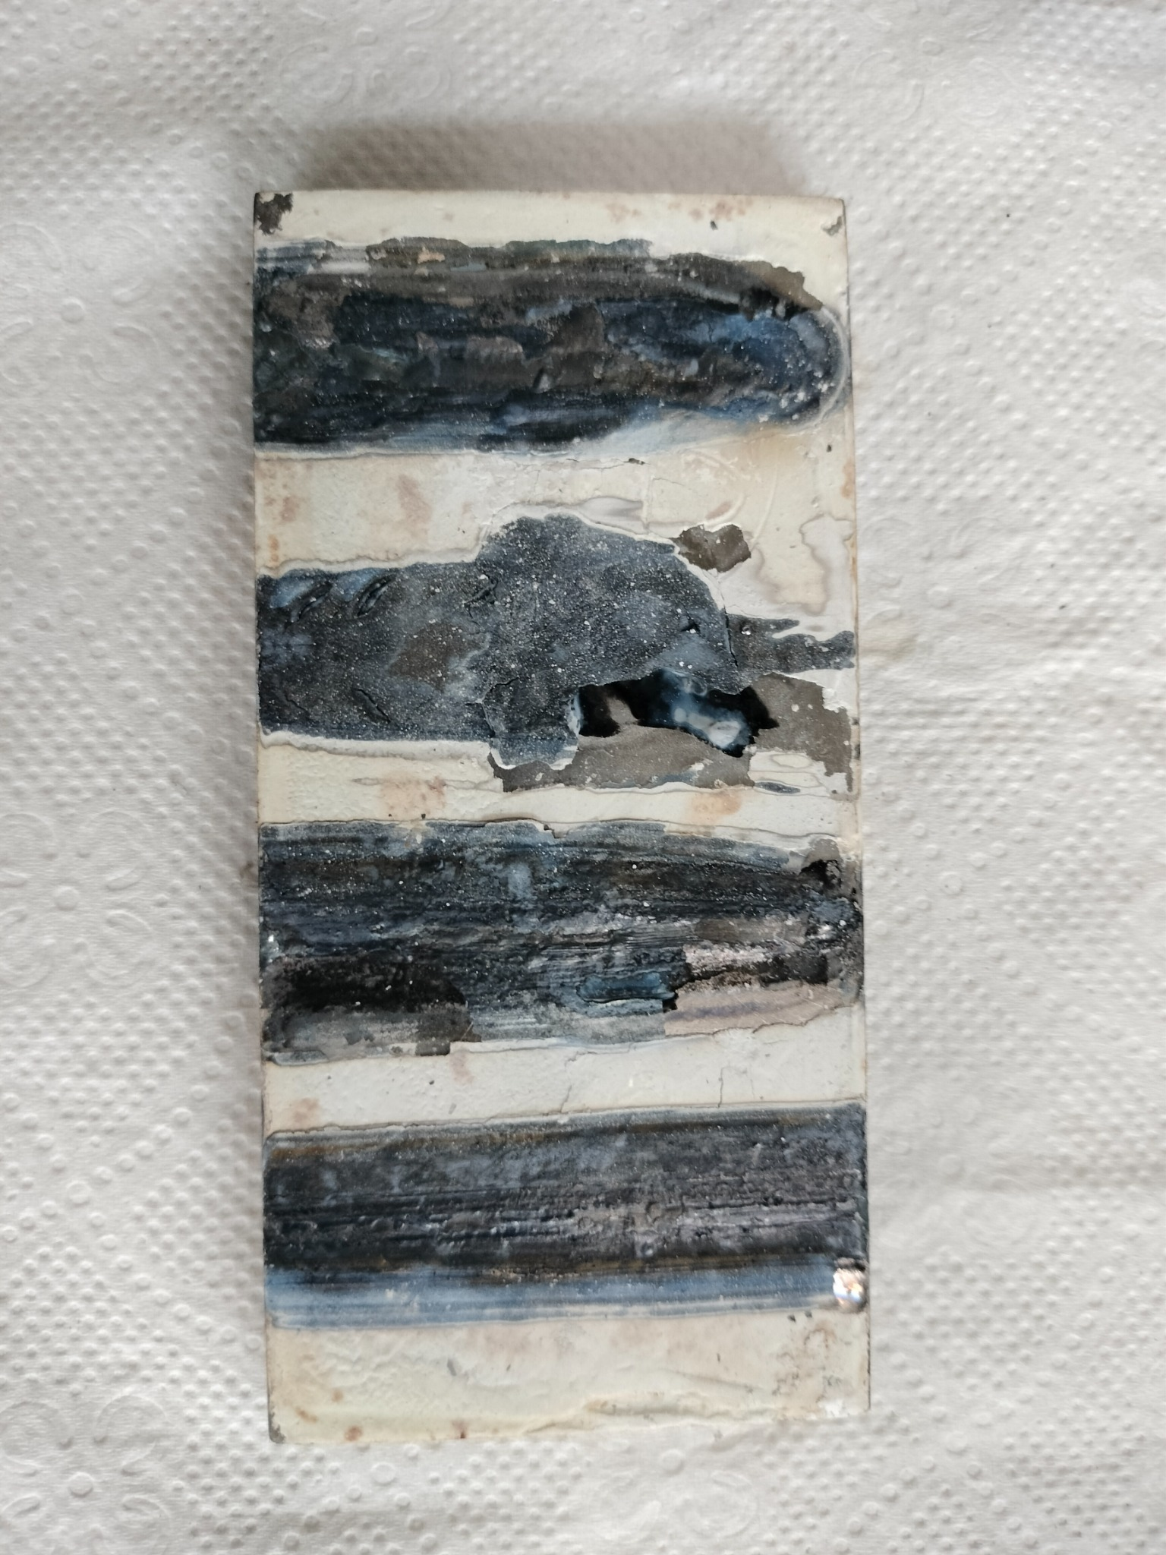
CURRENT WORK DONE — LASER TRIAL WITH LASER (Maxphotonics MFSC-3000X)
Trial performed for laser-parameter selection using a 3 kW Gaussian / multimode laser
LASER TRIAL DETAILS
LASER TYPE
Continuous Wave Fiber Laser
POWER
3 kW
VARIABLE
Scan speed(900,1200,1500mm/min)
EXPERIMENTAL APPROACH
Multiple laser tracks were produced on the pre-placed
precursor layer by varying the scan speed while
maintaining the laser power at 3 kW.
OBSERVATION
Track appearance and coating integrity varied with
scan speed, providing a basis for selecting suitable
processing conditions.
11
Status: scan-speed trials completed on the in-situ Route-A sample; refined parameters will be used for subsequent processing.

Slide 12
FUTURE WORK
Experimental workflow towards final comparative adhesion analysis
1
FINALIZE LASER PARAMETERS
2
PROCESS Ni–Al SAMPLES
Conduct a few more laser trials and evaluate coating integrity, track formation and coating quality to finalize stable processing parameters.
Repeat the optimized laser-processing route on AISI 1025 samples with the electrodeposited Ni/ Ni–Al/ Ni-Cr intermediate layer.
3
CHARACTERIZATION & TESTING
4
COMPARE ADHESION & PERFORMANCE
Complete metallography, SEM/EDS, XRD, microhardness, adhesion/scratch and sliding-wear testing for both coating architectures.
Compare direct CMC and Ni/ Ni–Al/ Ni-Cr assisted CMC coatings, focusing on coating–substrate adhesion and interfacial behaviour.
AISI 1025 → CMC VS. AISI 1025 → Ni/ Ni–Al/ Ni-Cr → CMC
12

Slide 13
References
[1] Y. Bao et al., “Insights into arc-assisted self-propagating high temperature synthesis of TiB2-TiC ceramic coating via wire-arc deposition,” J. Eur. Ceram. Soc., vol. 40, no. 13, pp. 4381–4395, Oct. 2020, doi: 10.1016/j.jeurceramsoc.2020.05.005.
[2] S. Chatterjee, S. M. Shariff, J. D. Majumdar, and A. R. Choudhury, “Development of nano-structured Al2O3-TiB 2-TiN coatings by combined SHS and laser surface alloying,” International Journal of Advanced Manufacturing Technology, vol. 38, no. 9–10, pp. 938–943, Sep. 2008, doi: 10.1007/s00170-007-1143-4.
[3] D. Dey, K. S. Bal, A. K. Singh, and A. Roy Choudhury, “Hardness and wear behaviour of multiple component coating on Ti-6Al-4V substrate by laser application,” Optik (Stuttg)., vol. 202, Feb. 2020, doi: 10.1016/j.ijleo.2019.163555.
[4] X. Lv, Z. Zhan, H. Cao, and C. Guo, “Microstructure and properties of the laser cladded in-situ ZrB2-ZrC/Cu composite coatings on copper substrate,” Surf. Coat. Technol., vol. 396, Aug. 2020, doi: 10.1016/j.surfcoat.2020.125937.
[5] Z. Zhang et al., “In-situ synthesis of (TiB2+TiC)/Cu composite coatings from powder precursors: A hybrid cold spraying and induction remelting approach,” Surf. Coat. Technol., vol. 517, Dec. 2025, doi: 10.1016/j.surfcoat.2025.132836.
13

Slide 14
THANK YOU
Development and Adhesion Analysis of Ceramic Matrix Composite Coatings
B.Tech Project Progress Presentation
14

